Slide 1

Exploratory Data Analysis-G2M Use Case
Muhammed Shehab
Egypt
Data and Analytics
11-March-2021

Slide 2

Agenda
Executive Summary
Problem Statement
Approach
EDA
EDA Summary

Slide 3
Use Case Overview – G2M
XYZ is a private equity firm in US. Due to remarkable growth in the Cab Industry in last few years and
multiple key players in the market, it is planning for an investment in Cab industry.
Objective : Provide actionable insights to help XYZ firm in identifying the right company for making
investment.
Dataset : Time period of data is from 31/01/2016 to 31/12/2018.
The analysis has been divided into four parts:
• Data Understanding
• Forecasting profit and number of rides for each cab type
• Finding the most profitable Cab company
• Recommendations for investment

Slide 4
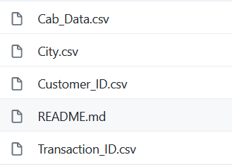
Data Exploration
12 Features( including 9 derived features)
Timeframe of the data: 2016-01-31 to 2018-12-31
Total data points :359,392
Assumptions:
Profit of rides are calculated keeping other factors constant and only
Price_Charged and Cost_of_Trip features used to calculate profit.

Slide 5
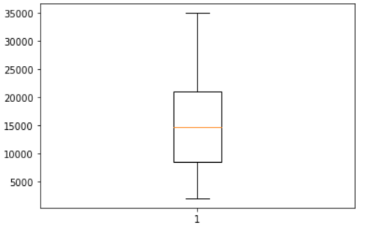
Profit Analysis
Figures – Income Analysis
Below is the Income of the customers for both companies in order to study the customer behavior and segment them according to their incomes.
- Insights :
Income of the people lies between 20K and 9K.

Slide 6
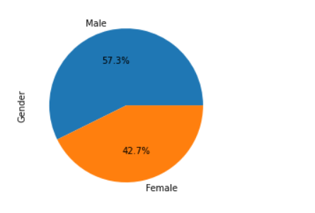
Profit Analysis
Figures – Gender Analysis
Gender is a crucial feature used in EDA
- Insights :
Almost 58% of the people are males for both companies

Slide 7
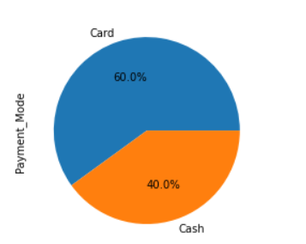
Profit Analysis
Figures – Payment Analysis
- Insights :
People tend to pay using Credit/debit Card instead of Cash

Slide 8
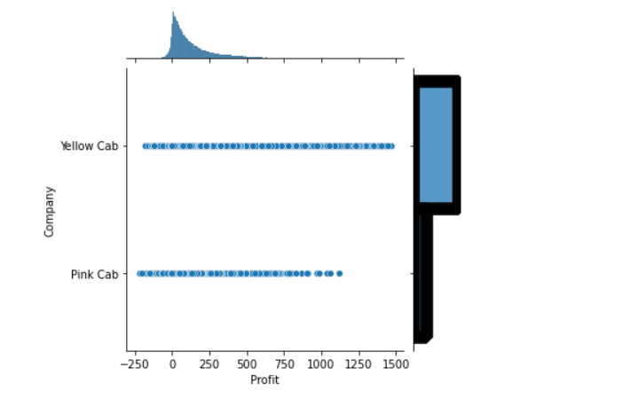
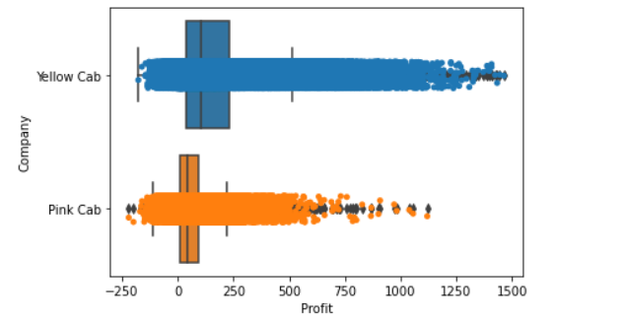
Profit Analysis
Figures – Profit Analysis
- The main feature that affects the overall decision is the profit; as a investor people tend to invest in a well known and stable company with the highest revenue.
- Insights :
Investors might think of Yellow Cab Company as a first option.

Slide 9
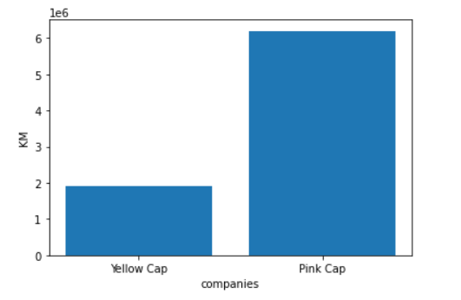
Profit Analysis
Figures – KM Analysis
- The Distance travelled by the Pink Cap is way larger than the distance travelled by Yellow Cab.
- Insights :
This feature might support the Yellow Cap Company more as the Pink Cap Company travelled more distance but with less profit than the other company.

Slide 10
Thank You

